Slide 1
Front End Engineering-I Project
Team Details:
Prajyant Veer Siag (LEADER)
2310992494
Prabhnoor Singh
2310992393
Faculty Coordinator: Dr. Ratan Deep Aneja
:
Chitkara University Institute of Engineering and Technology,
Chitkara University, Punjab

Slide 2
Table of Contents
Introduction
Problem Statement
Technical Details
Key Features
Project Highlights
Conclusion
References/Links used

Slide 3
Introduction
Title- Memory Card Match Game
Team Members:
Prajyant Veer Siag
Prabhnoor Singh
Overview: The Memory Card Match Game is a web-based educational game designed to enhance memory and cognitive skills. Our team's goal is to provide an engaging and fun experience for players of all ages. The game presents a grid of cards, each with a hidden symbol. Players flip cards to find matching pairs while testing their memory. The project aims to promote cognitive development, concentration, and problem-solving abilities in an entertaining and accessible way. Through this game, we aspire to offer a valuable tool for individuals seeking to improve their mental agility while having an enjoyable gaming experience.

Slide 4
Problem Statement
Problem Statement: The Memory Card Match Game aims to address the challenge of cognitive decline and the need for engaging, accessible tools to improve memory and mental agility.
Background and Research: Cognitive decline is a common concern among aging populations and individuals of all ages due to increasing screen time and information overload. Memory and cognitive abilities play a vital role in daily life, from basic tasks to complex problem-solving. Research shows that engaging in activities that challenge and stimulate the brain can help delay cognitive decline and enhance cognitive abilities.
Traditional memory games have demonstrated benefits in memory improvement and cognitive enhancement. However, in today's digital age, there's a need for accessible, online alternatives. The Memory Card Match Game leverages the familiarity of the classic memory game format while providing an interactive, web-based solution that can be enjoyed by a wide range of individuals.

Slide 5
Technical Details
In the memory card mix-or-match game, several technologies and methods are used to create an interactive and engaging user experience:
HTML (Hypertext Markup Language): HTML is the foundation of the game's structure. It is used to define the layout and content of the web page, including headings, text, images, and the game board.
<div> tag: The <div> tag defines a division or a section in an HTML document. The <div> tag is used as a container for HTML elements - which is then styled with CSS or manipulated with JavaScript. The <div> tag is easily styled by using the class or id attribute.
<br> tag: The <br> tag inserts a single line break. The <br> tag is useful for writing addresses or poems. The <br> tag is an empty tag which means that it has no end tag.
<img> tag: The <img> tag is used to embed an image in an HTML page. Images are not technically inserted into a web page; images are linked to web pages. The <img> tag creates a holding space for the referenced image.
<footer> tag: The <footer> element is a structural element used to identify the footer of a page, document, article, or section.

Slide 6
Technical Details
CSS (Cascading Style Sheets): CSS is used to style and format the game's elements. It defines the visual presentation of the game, including fonts, colors, positioning, and responsive design.
Color property: The color property in CSS is used to set the color of text, the background of the webpage, and also to set the color of borders.
Border Color property: The border-color property sets the color of an element's four borders. This property can have from one to four values.
Display property: The display property specifies the display behavior (the type of rendering box) of an element. In HTML, the default display property value is taken from the HTML specifications or from the browser/user default style sheet.
Font size property: The font-size property sets the size of a font.
Font family property: The font-family property specifies the font for an element. The font-family property can hold several font names.
Transform property: The transform property applies a 2D or 3D transformation to an element. This property allows you to rotate, scale, move, skew, etc., elements.

Slide 7
Technical Details
Javascript: JavaScript has been used to generate random cards, checking for matches, for sound effects and to display the scores of the user. JavaScript has been used to create interactive client-side functionality for the website.
This property: In JavaScript, the “this” keyword refers to an object. Alone, this refers to the global object. In a function, this refers to the global object.
New property: New keyword in JavaScript is used to create an instance of an object that has a constructor function.
Return property: The return statement stops the execution of a function and returns a value
getElementByID method: The getElementById() method returns an element with a specified value. The getElementById() method returns null if the element does not exist.
if-else statements: The if/else statement executes a block of code if a specified condition is true. If the condition is false, another block of code can be executed.
Arrays: Arrays are Objects. Arrays are a special type of objects. The typeof operator in JavaScript returns "object" for arrays.

Slide 8
Technical Details
Python: We have implemented python to create the login page. The access to our website is only granted if the user enters correct username and password. Moreover, the login window has also been styled using python.
tkinter module: Tkinter is a Python interface to the Tk graphics library.It can be used to create Graphical User interfaces (GUIs).
import: In Python, you use the import keyword to make code in one module available in another. Imports in Python are important for structuring your code effectively.
def keyword: The def () keyword in python is used to define the function that users can use to built their own function.
if-else statements: The if/else statement executes a block of code if a specified condition is true. If the condition is false, another block of code can be executed.
window.geometry(): This method is used to set the dimensions of the Tkinter window and is used to set the position of the main window on the user’s desktop.
window.mainloop(): window.mainloop() tells Python to run the Tkinter event loop. This method listens for events, such as button clicks or keypresses, and blocks any code that comes after it from running until you close the window where you called the method.

Slide 9
Key Features
To create an effective memory card mix-or-match game, you'll need several key features to solve the problem and ensure an enjoyable gaming experience. Here are the essential features:
Card Generation: Dynamically generate a grid of cards, each with a unique identifier, to serve as the game board. The cards should be shuffled randomly at the beginning of each game.
Timer: Add a countdown timer to create a time limit for completing the game. Display the remaining time to players and end the game when the timer reaches zero.
Flips: The number of flips a user makes have also been added to the website so the player can beat it’s own score.
Victory screen at the end of the gameplay to tell the score of the player.
Custom cursor style which changes when hovered to cards makes the game even more engaging.
Responsive design has been incorporated in the game so that it can be enjoyed on various screen sizes.

Slide 10
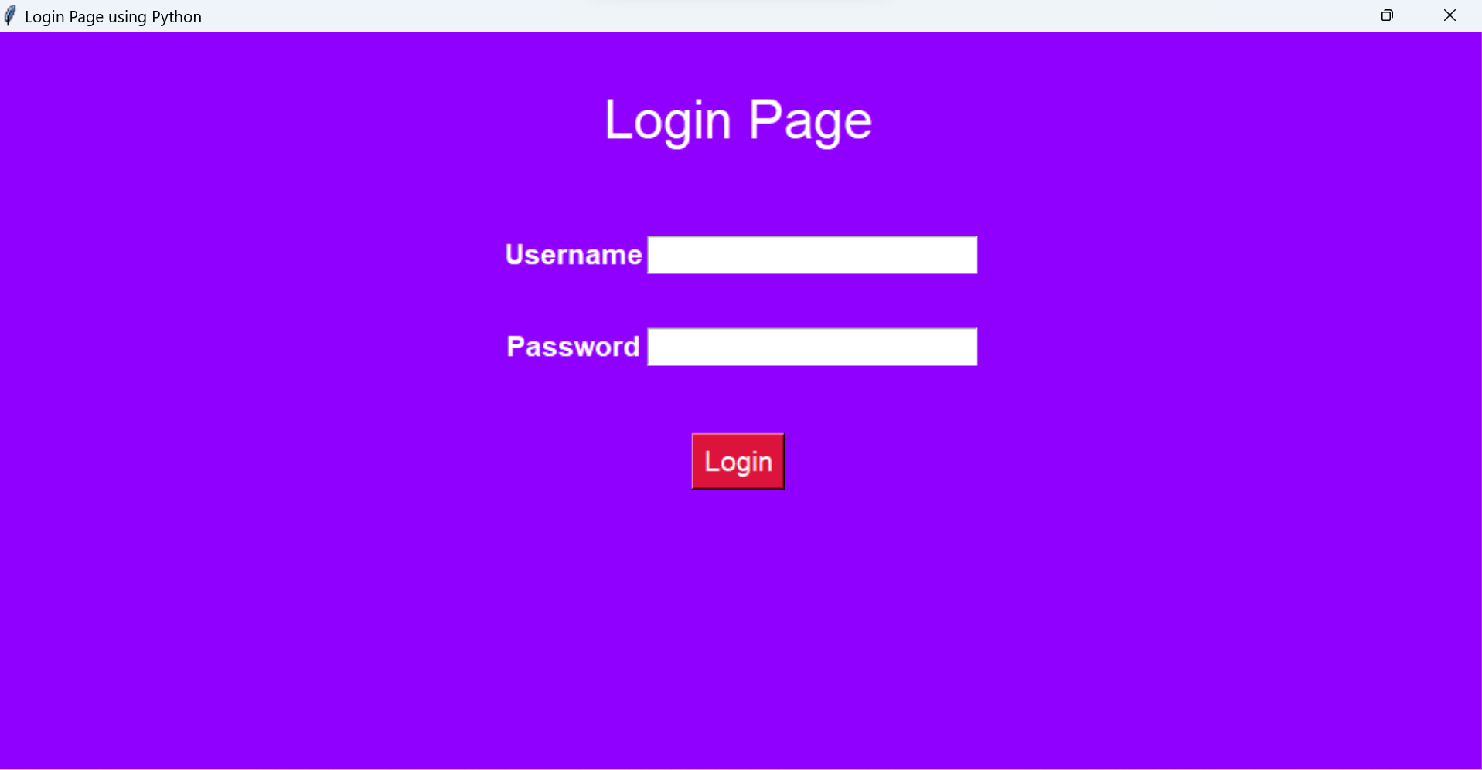
Project Highlights
This is our login page created using python. Only after successful login, you are redirected to our website.

Slide 11
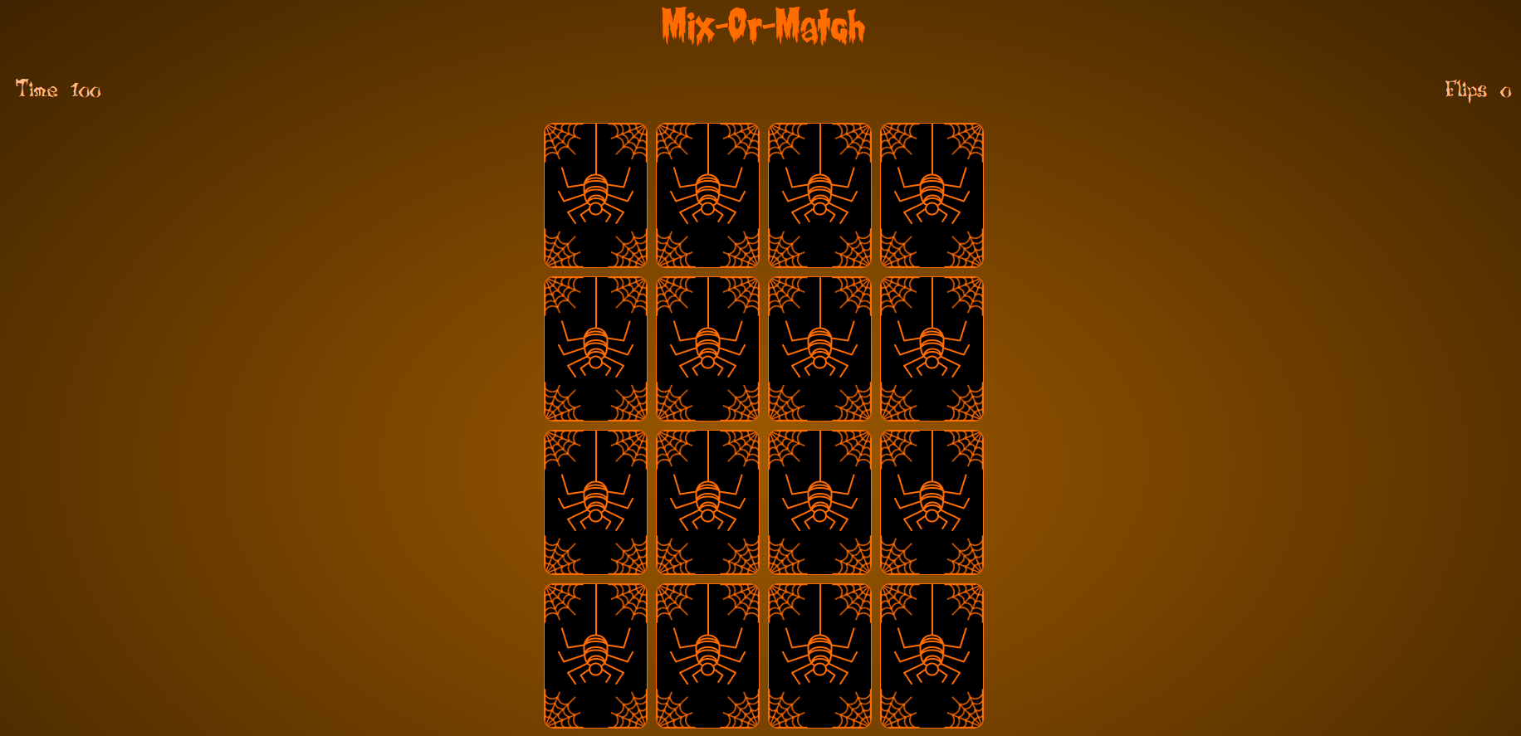
Project Highlights
Here you can see the Mix or match game with a Timer on in top left side and you can the number of flips made by the player on the top right side. There are 16 cards in which the player has to find 8 pairs on matching cards.

Slide 12
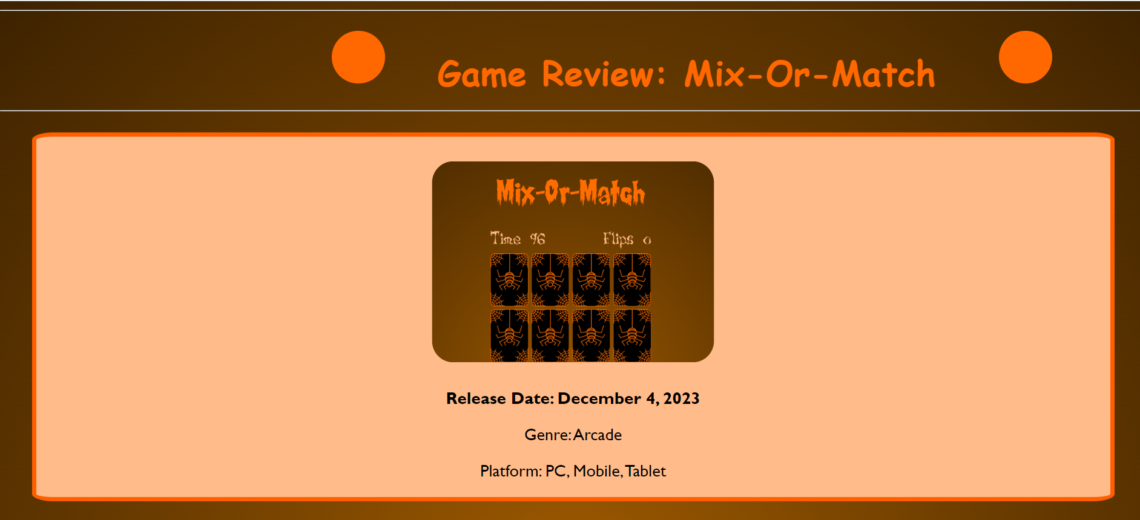
Project Highlights
Reviews about the game has been added under the review page which is directly linked to the main website.

Slide 13
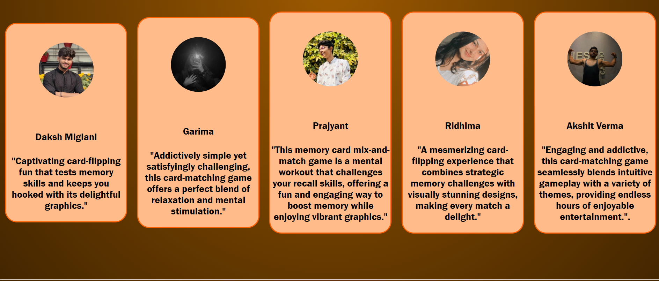
Project Highlights
Reviews from various persons.

Slide 14
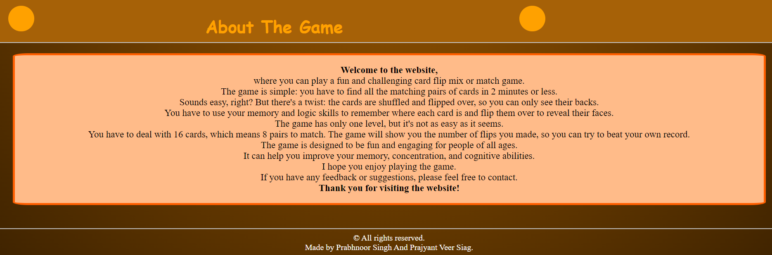
Project Highlights
The about section of the game written as the footer of the website.

Slide 15

Project Highlights
This is what is user is prompted if he is unable to find all the matching pairs in the given time limit.

Slide 16
Conclusion
The project's core focus was the creation of a memory card mix-or-match game, leveraging HTML, CSS, and JavaScript. The team effectively implemented critical game features such as card generation, flipping mechanics, matching logic, and responsive design for varying screen sizes. Key takeaways include the importance of user-centered design, responsive web development, structured coding practices, and accessibility considerations, collectively enhancing the team's web development skills and understanding.

Slide 17
References/Links used
https://www.codingnepalweb.com
https://codepen.io
https://dev.to

Slide 18


